Slide 1

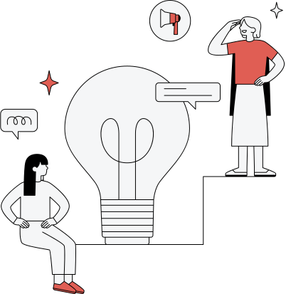


Healthy teams achieve better results.
Employee Wellness Management Analytics
Support Employee’s Mental Health and Sentiment Remotely
Presented By:
Team 4
Rishit Ranjan
Ritheesh Reddy
Sanjana Teggi
Simran Hakim
Shivendra Tripathi
Sudip Madhu

Slide 2





Problem Statement
Current System’s Limitations and Issues
Lack of a secure and centralized login and wellness management system.
Difficulty in managing user/admin access and employee wellness records.
Limited real-time analysis of workforce performance and health trends.
Need for instant wellness guidance through an intelligent chatbot with natural language response.

Slide 3

Knowing about the Project
Employee wellness is essential for strong productivity and steady growth. The system helps manage health data and spot risks like stress while offering personal wellness tips.
Employee wellness plays a big role in performance and growth. This system handles health data, predicts risks, and gives each person wellness ideas that support their wellbeing.
Supporting employee wellness leads to better focus and stronger results. The system works with wellness data, identifies stress risks, and shares recommendations and the sentiment to help everyone stay healthy.
Introduction

Slide 4


Project Objective
Objectives of the Project
Personalized Employee Dashboards: Tracks vitals, sets goals, and delivers custom AI insights.
Proactive Admin Analytics: Enables predictive risk modeling, sentiment tracking, and key KPIs.
24/7 AI Wellness Assistant: Provides instant, contextual advice on diet, stress, and exercise.
Secure & Scalable Infrastructure: Ensures data privacy, role-based access, and centralized analytics.
Automated Admin & Emergency Response: Streamlines claims, scheduling, and instant SOS alerts.

Slide 5

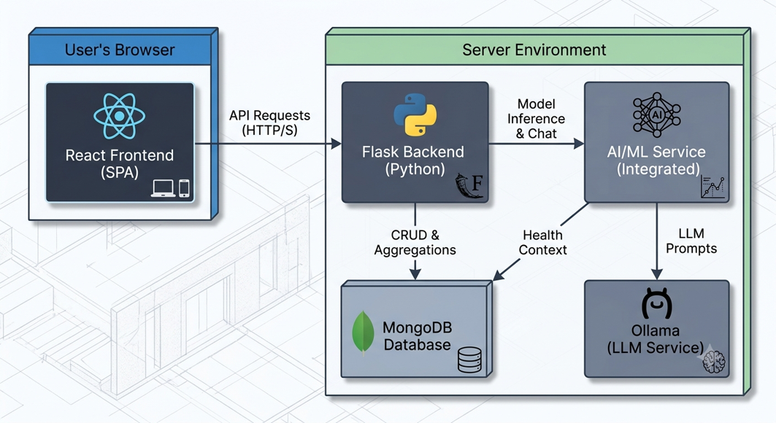
System Architecture
Explaining the structure and flow of the system.
The application is built on a modern, decoupled architecture, commonly known as a Backend for Frontend (BFF) pattern.
This means the React frontend is a distinct application that communicates with a dedicated Flask backend via a REST API
Microservice-Ready AI Integration: Isolates LLM interactions and machine learning model inference into modular background services to maintain high responsiveness and system efficiency.
Stateless Token Authentication: Utilizes secure JWT authorization across API requests, ensuring strict role-based access control and seamless horizontal scaling.

Slide 6

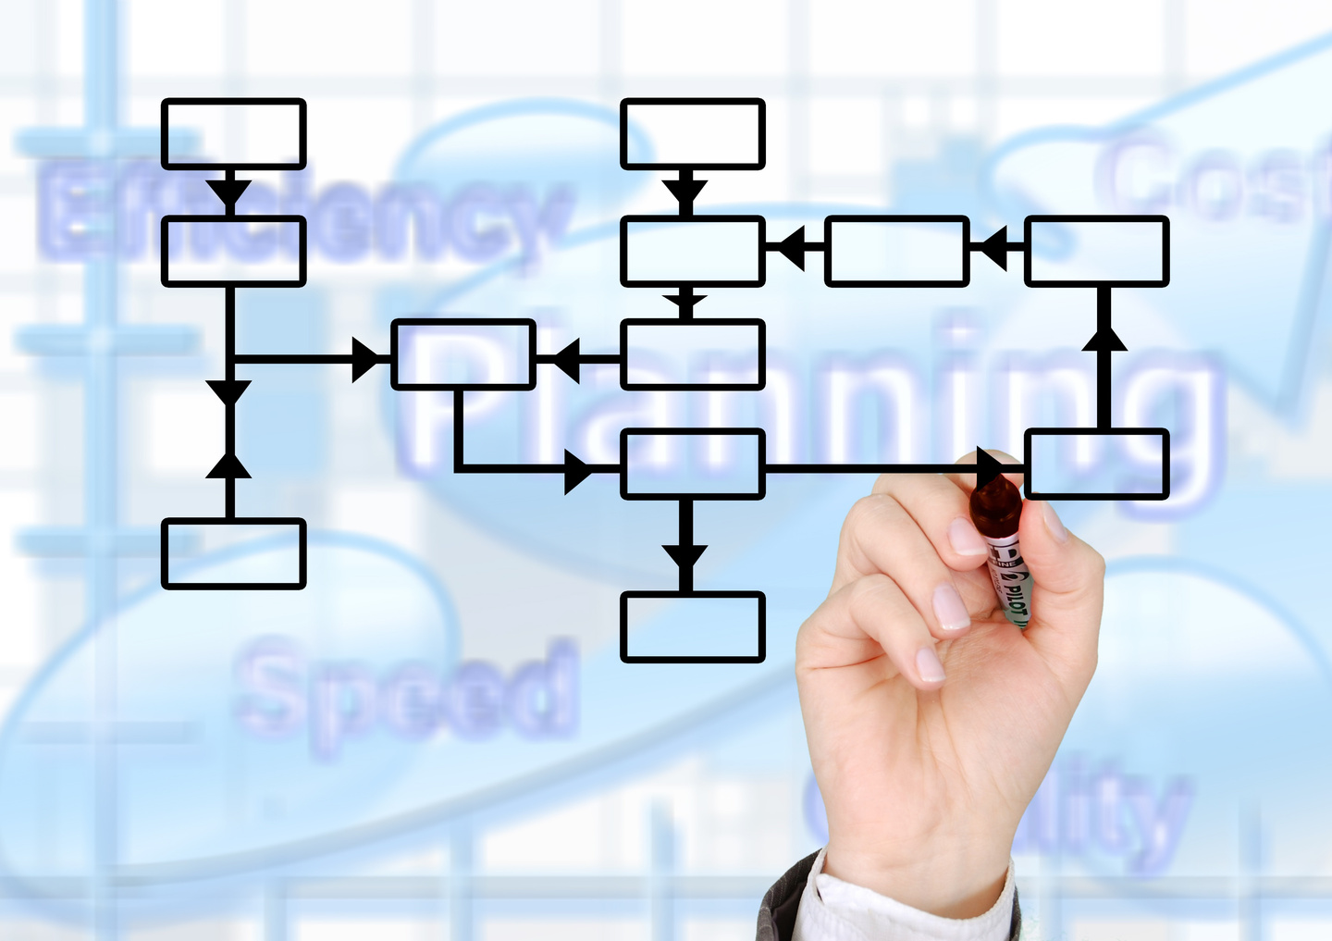
Methodology
How the system was developed and works step-by-step.
The system was developed in a modular way, starting with secure user authentication and role-based access for employees and admins.
After that, the frontend, backend, and database were connected to manage wellness records, analytics, and user interactions smoothly.
Finally, AI-based features such as risk prediction, recommendations, sentiment analysis, performance analytics, and chatbot support were added to make the platform smarter and more useful.

Slide 7


Software Specification
Software Requirements to run on local machine
Flask API with Python and NodeJs.
Database: MongoDB.
Authentication: JWT and bcrypt for secure login and password handling.
Tools/Libraries: React Router, Flask-CORS, PyMongo, and ML libraries for wellness analytics.

Slide 8
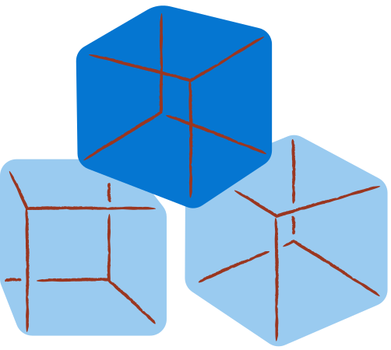

Core
Modules

Slide 9
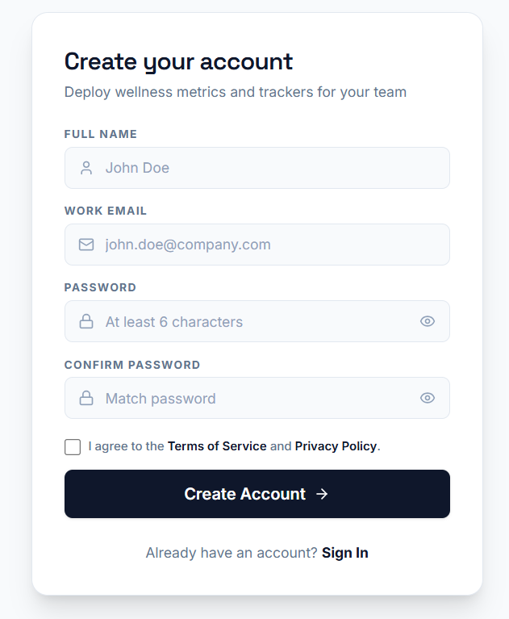
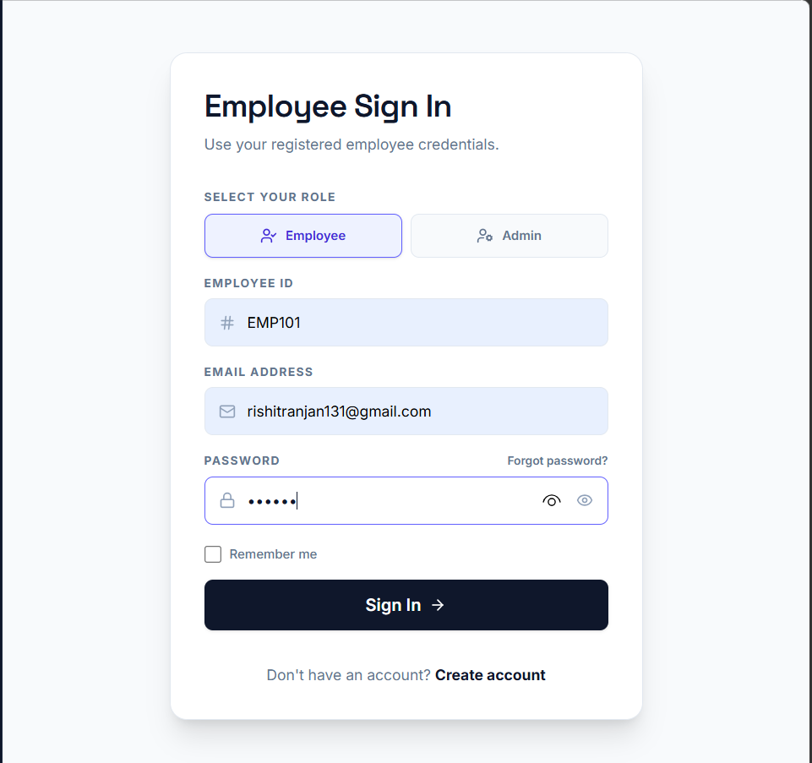


Login
&
SignUp
Module
SignUp and SignIn
User login with email and password.
User registration with required fields.
Remember me option in login form.
Forgot password flow with email, OTP, and reset password steps in the frontend prototype.
Role-based redirect to user or admin dashboard after authentication.

Slide 10
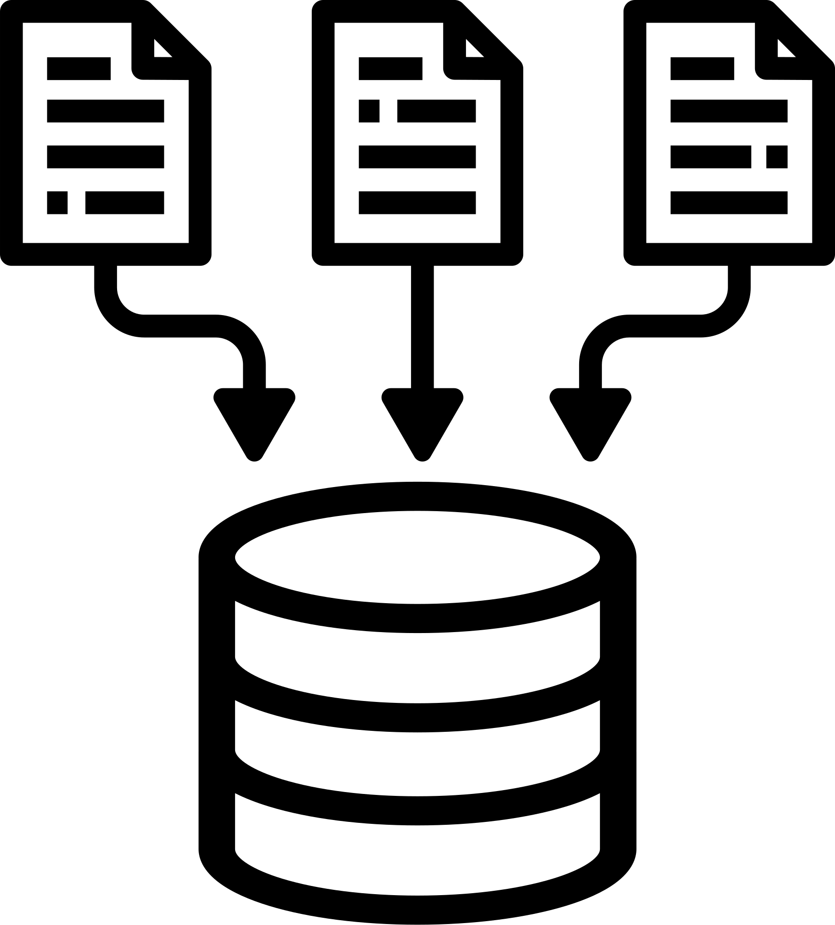
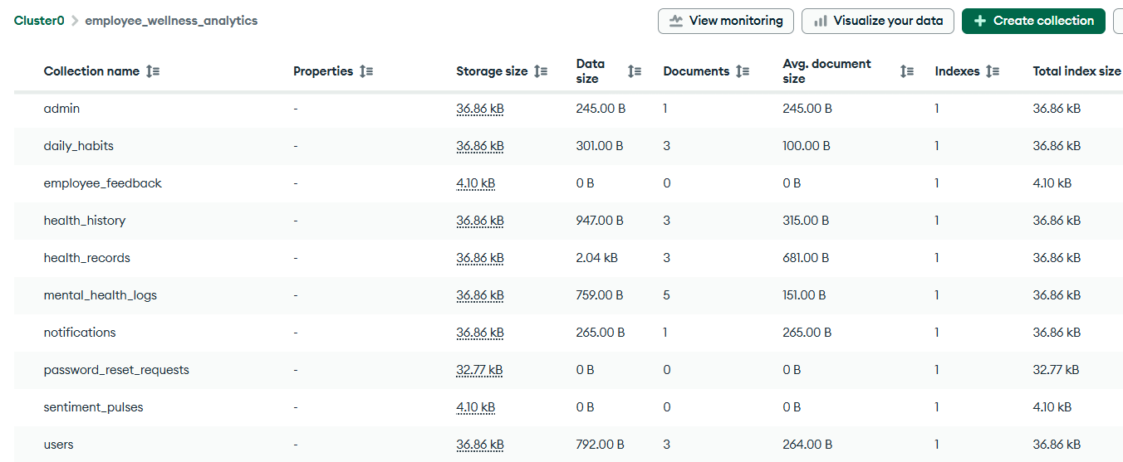
Database
Database Management of the Employee Data
The backend connects to MongoDB using PyMongo.
User-related data is stored in collections including admin and employees in JSON - like format.

Slide 11

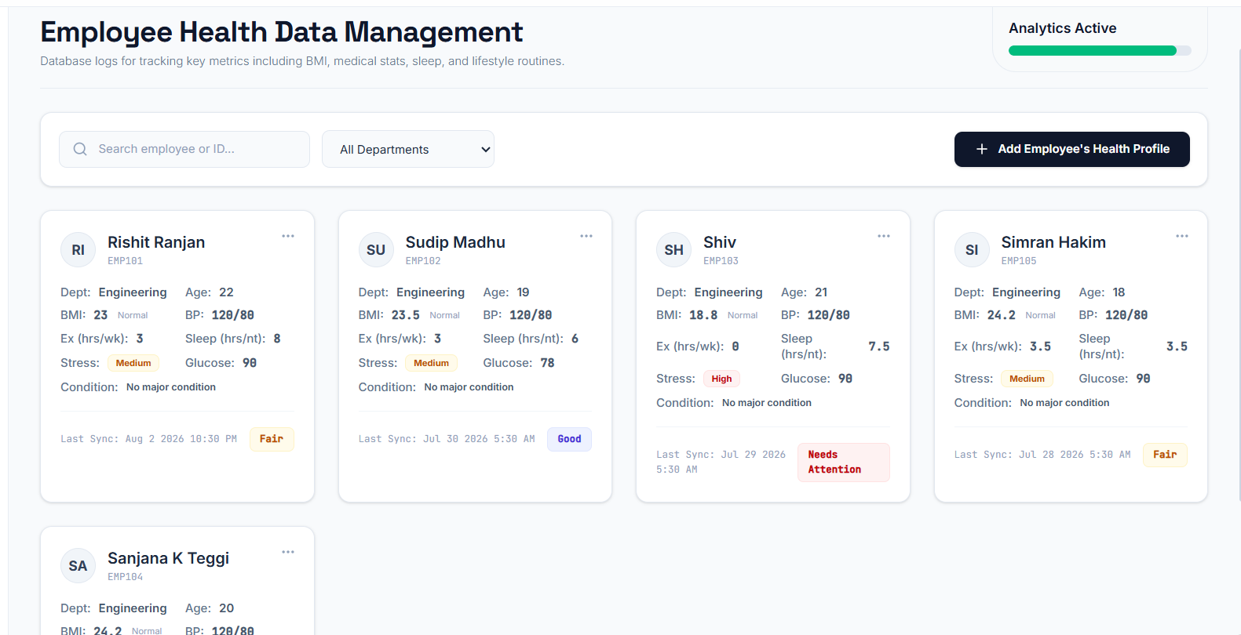
Health Records Collection
Collecting the Health Record
BMI and medical reports.
Exercise and sleep tracking.
Attendance and assessments.
Data preprocessing and validation.

Slide 12
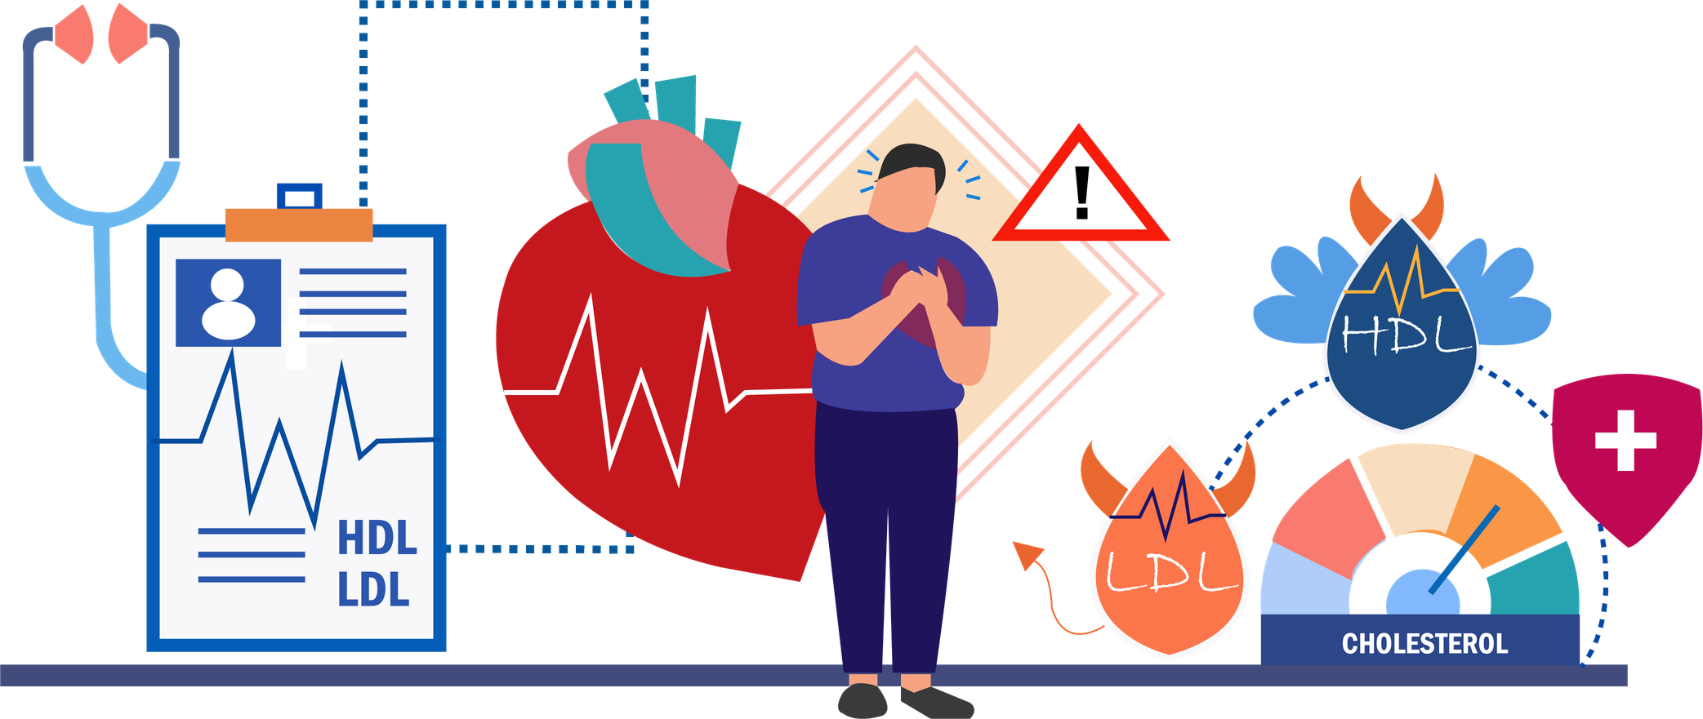
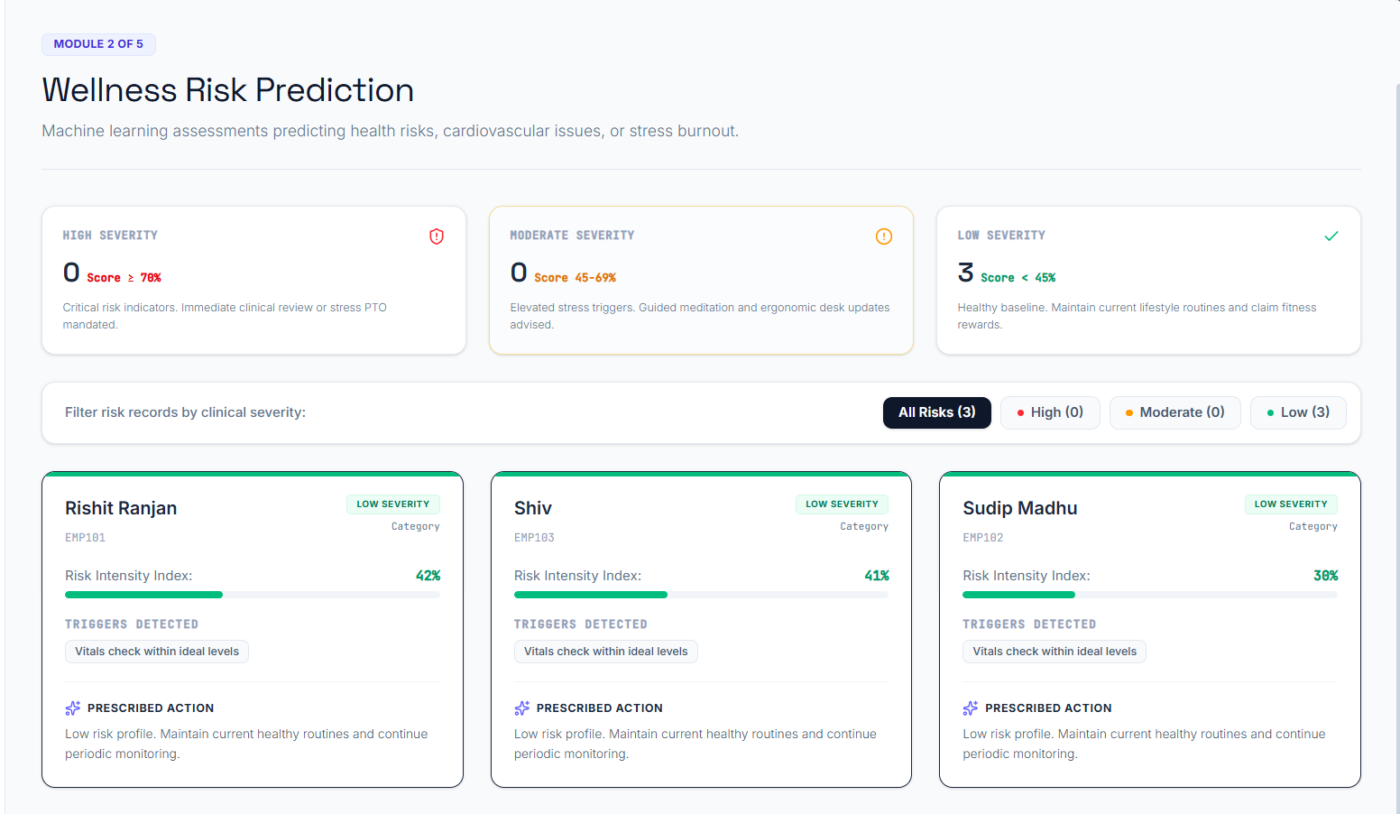
Wellness Risk Prediction
Predicting the Risk
Predicts stress and burnout.
Detects obesity and hypertension risk.
Uses historical and real-time data.
ML: Decision Tree, Random Forest

Slide 13


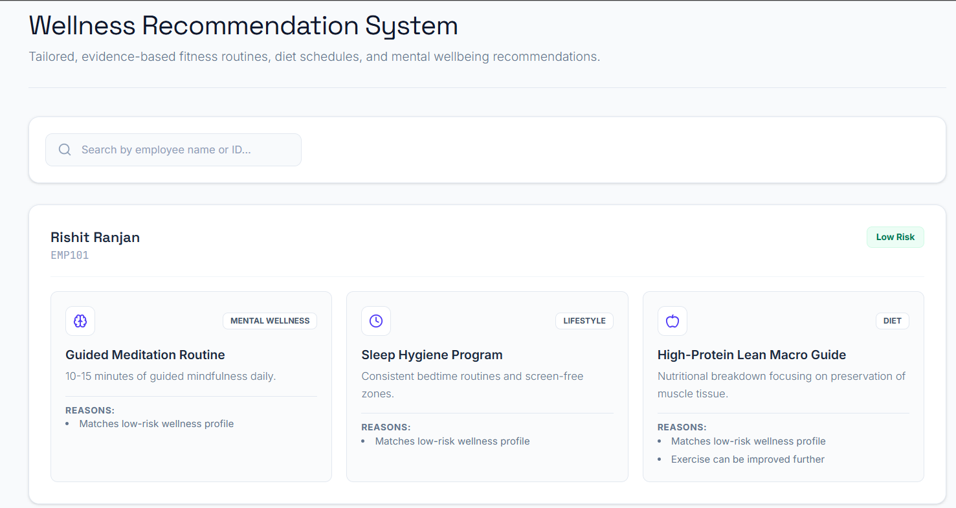
Personalized Wellness Recommendation
Employee Wellness Recommendation
Personalized fitness plans
Diet and lifestyle suggestions
Mental wellness and yoga activities
AI: collaborative filtering, content-based filtering, Generative AI

Slide 14
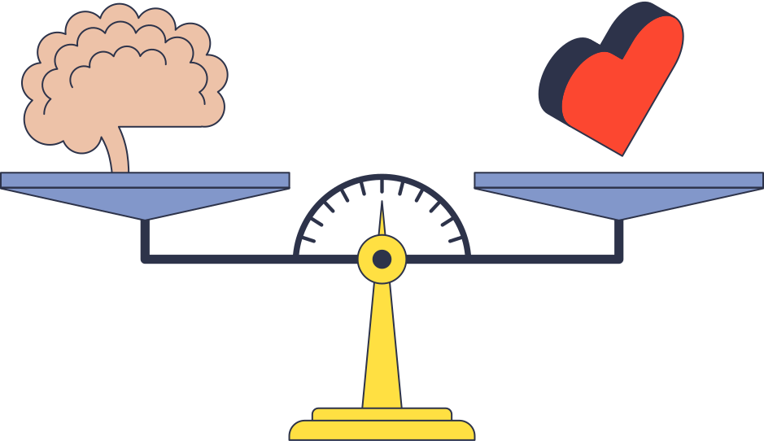

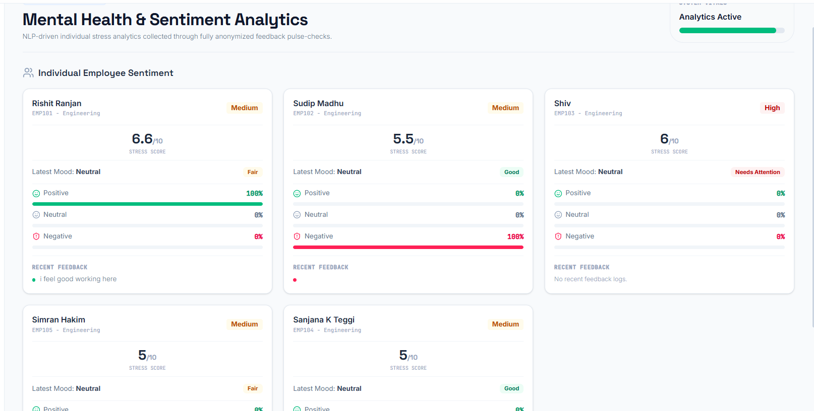

Mental Health &
Sentiment Analysis
Sentiment and Mental Health
Analyzes surveys and feedback.
Can use emails with consent and chatbot conversations
Detects stress, anxiety, burnout.
NLP, sentiment analysis, emotion detection

Slide 15
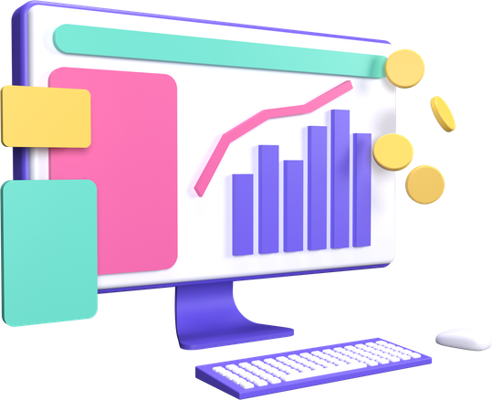
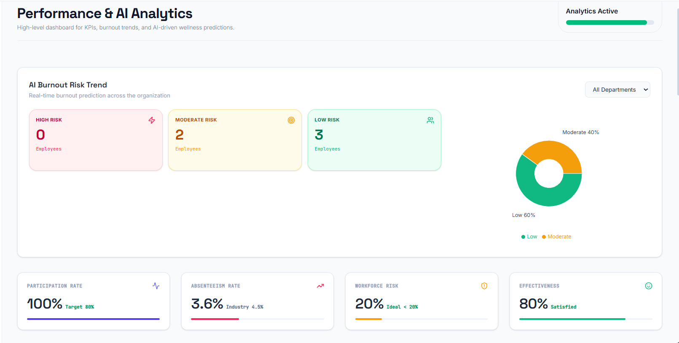
Performance
&
AI Analysis
Employee Performance Metrics
Tracks absenteeism and workforce health risk.
Measures wellness program effectiveness.
Helps admin monitor employee performance trends.

Slide 16

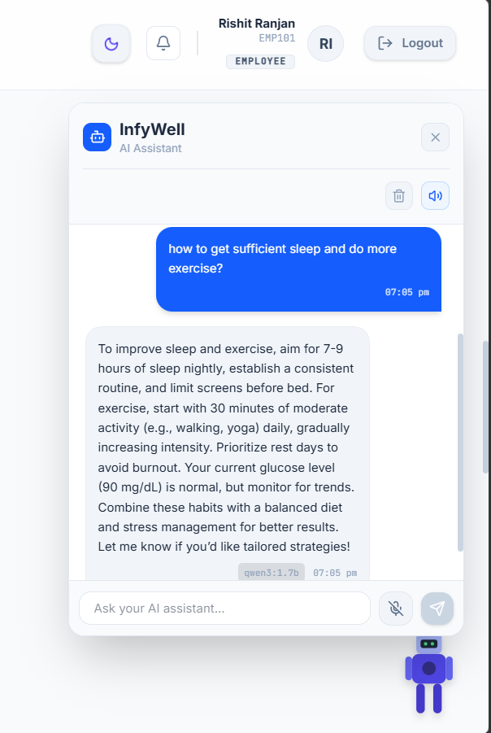
Chatbot Module
Chatbot Support and Assistance
AI-powered wellness assistant for employees.
Answers questions on sleep, diet, exercise, stress, and burnout.
Provides interactive chat support inside the user dashboard.

Slide 17


Additional
Features

Slide 18


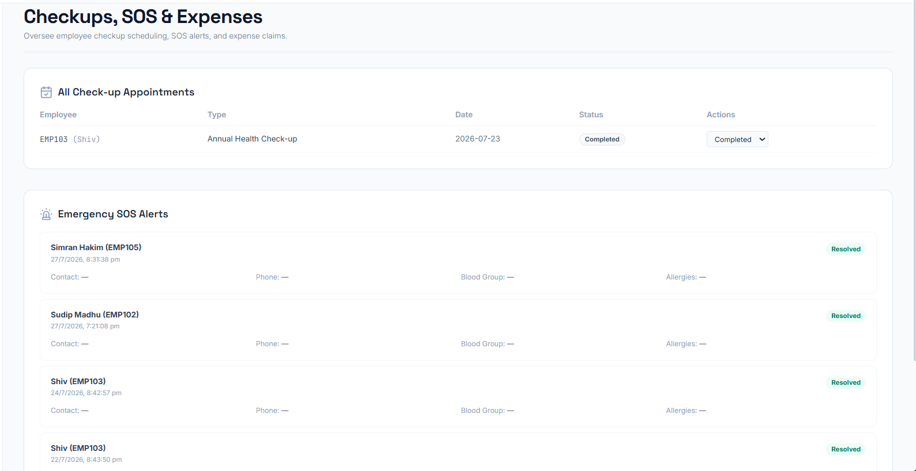
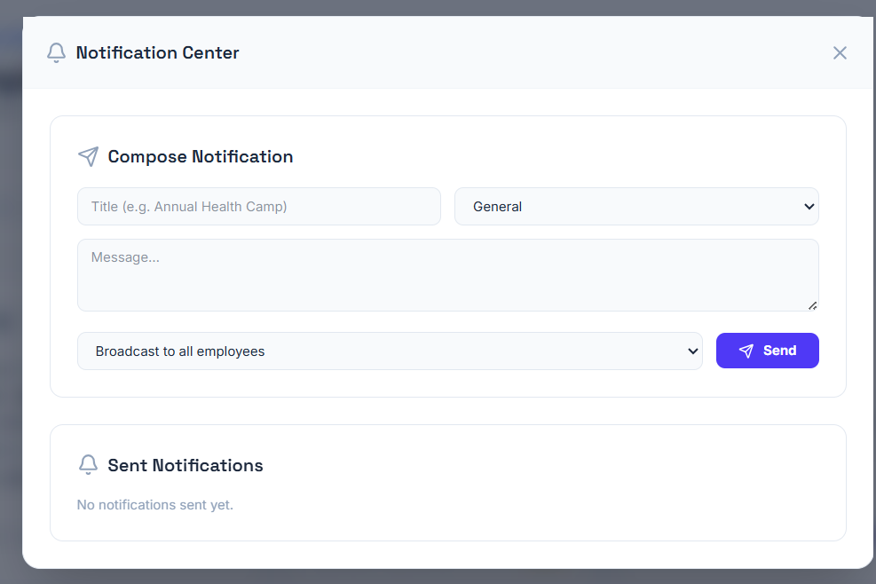

Admin Dashboard
Added Features for Analytics
Added wellness-focused extension modules.
Send announcements across all employees or each individually.

Slide 19

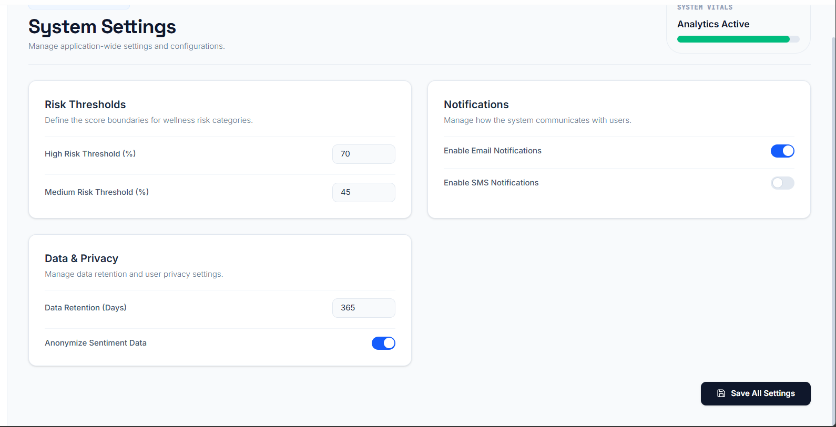
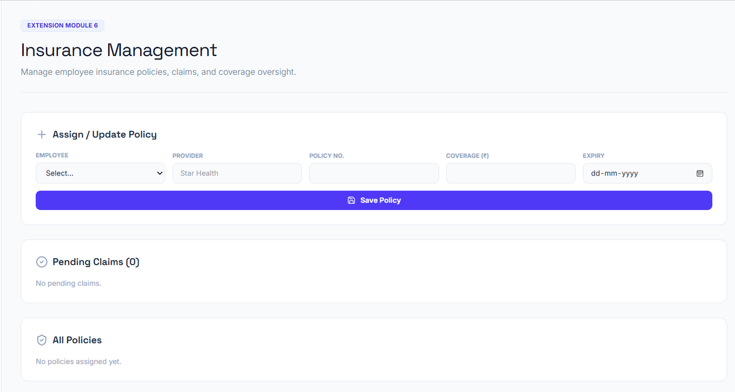
Admin Dashboard
Added Features for Analytics
Track employee claims and policy status.
System Settings for Managing application-wide settings and configurations.

Slide 20

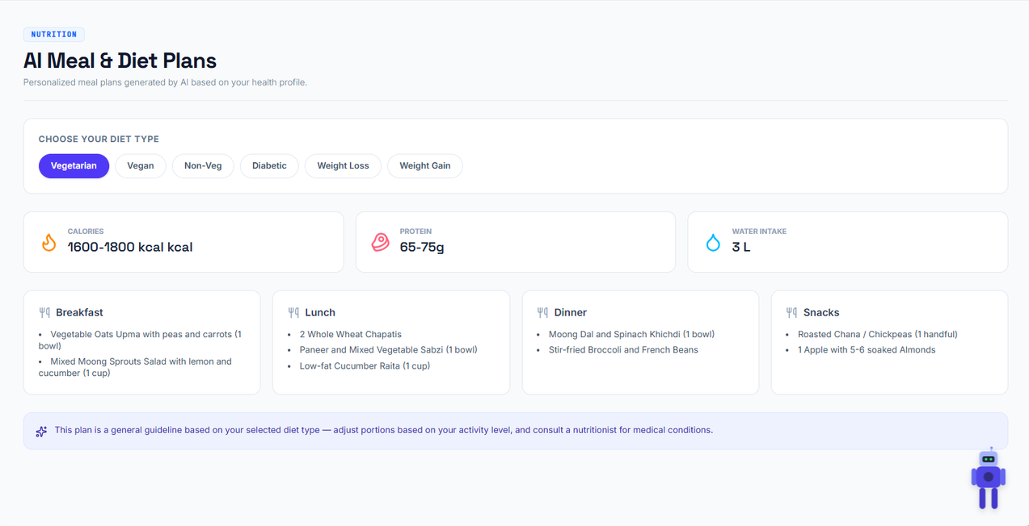

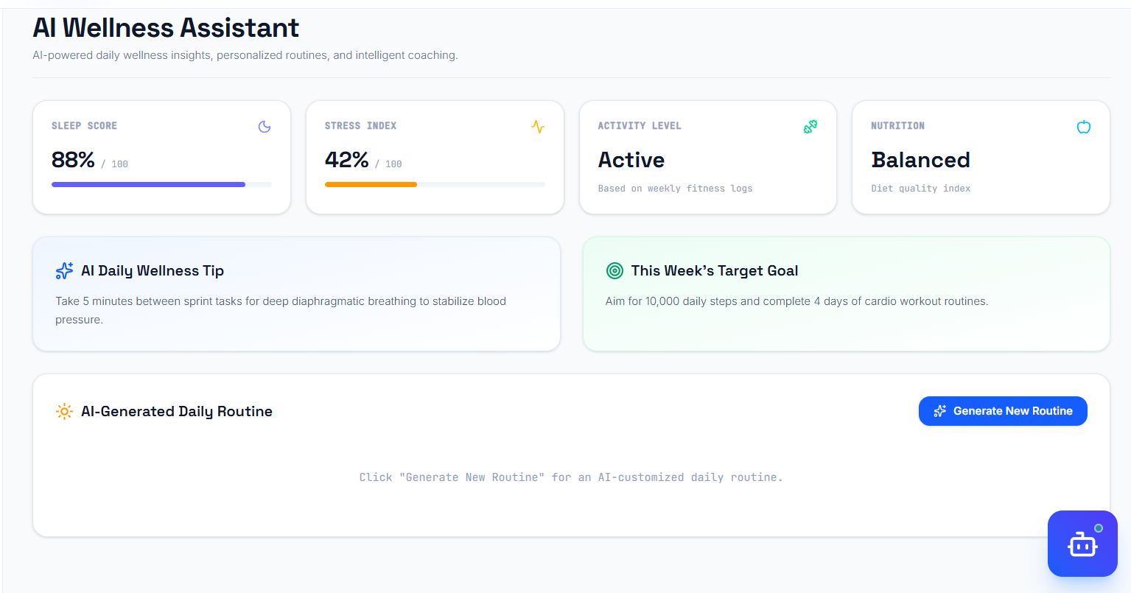
Employee Dashboard
Added Features for Wellness
Integrated AI wellness coach
Added diet plans for the selected diet type based on user preference

Slide 21

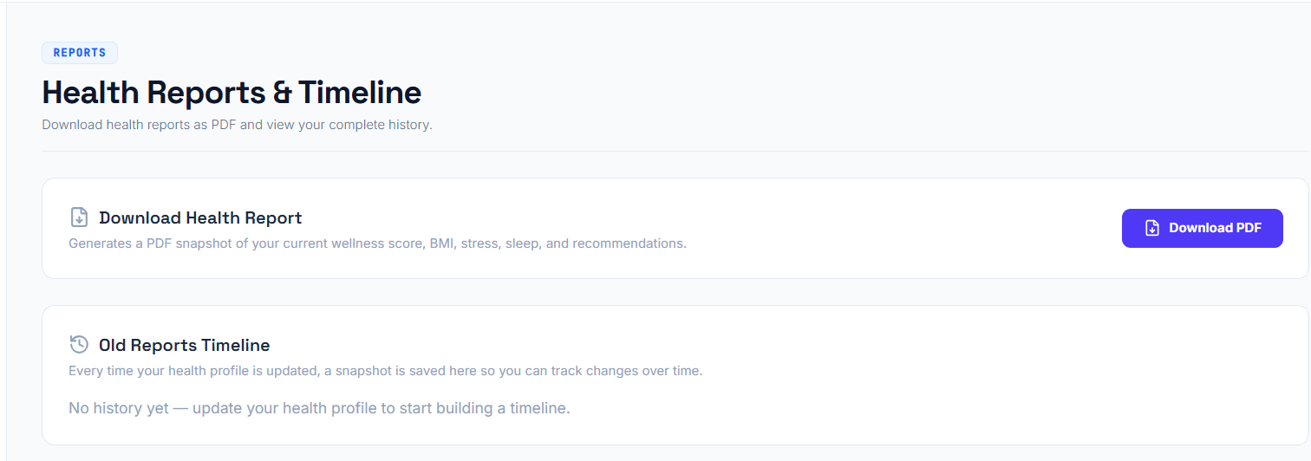
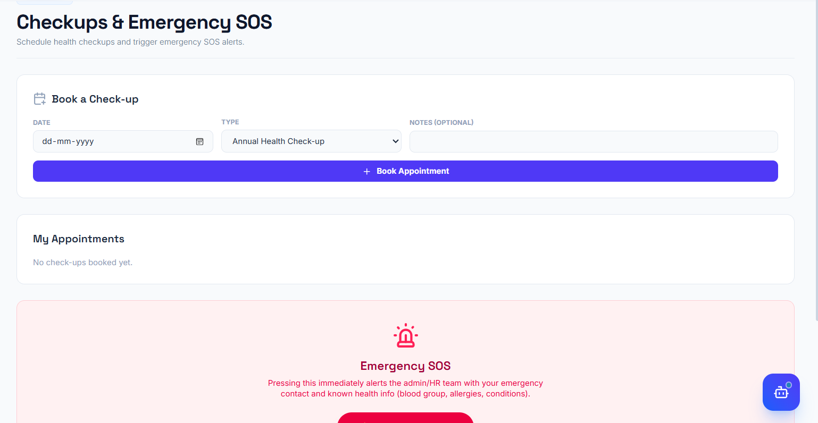
Employee Dashboard
Added Features for Wellness
Downloadable Health reports in PDF format.
Schedule checkups and Emergency SOS trigger

Slide 22



Conclusion
The project includes secure authentication, database integration, risk prediction, recommendation, sentimental analysis, performance analytics, and an AI wellness chatbot in one platform.
It supports both employee and admin roles for managing wellness data and system features.
These modules make the system more intelligent, interactive, and useful for future expansion.

Slide 23

Thank you so much

